Slide 1
Neuromorphic Architecture
Ryan Darras

Slide 2
Moore’s Law - History
Gordon Moore (1965) - “The number of transistors in a dense integrated circuit doubles every year.”
Gordon Moore (1975) - “The number of transistors in a dense integrated circuit doubles every two years.”
Gordon Moore (2015) - “I see Moore’s law dying here in the next decade or so.”
Intel (2015) - “Our cadence today is closer to two and a half years than two.”
Intel (2018) - Leak on Intel Ice Lake CPU, 10nm. A 3 year cadence of Moore’s law.

Slide 3
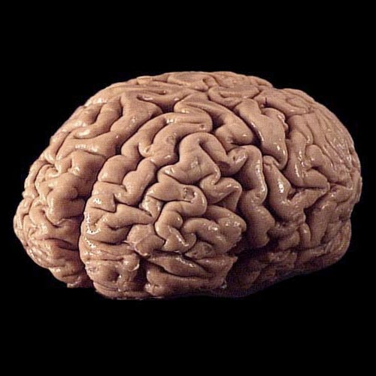
CPU
Problem solvers.
What else is a good problem solver?

Slide 4
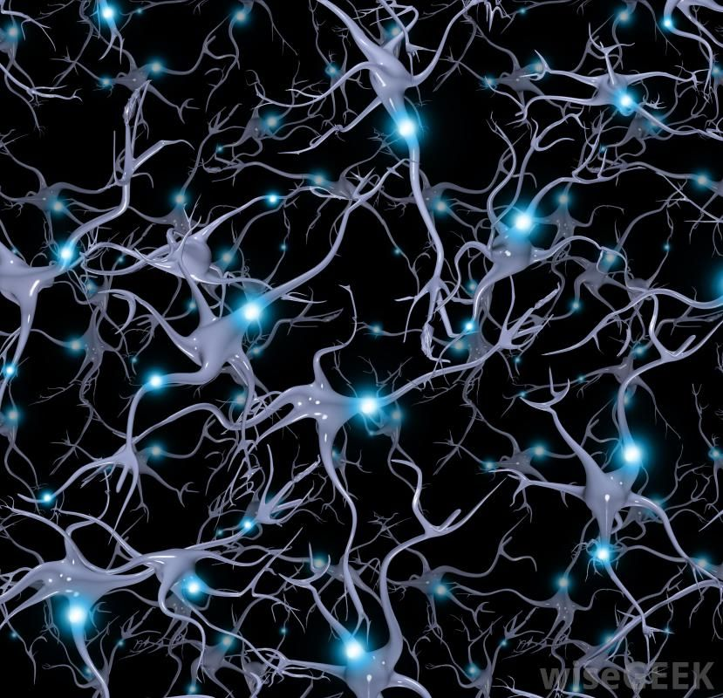
Let's build a CPU like a brain
Mimic a brains ion channels with electrons and transistors instead of chemicals like sodium and calcium.
“Synapses” connect cores to other cores which causes each core to operate in conjunction with each other.
Each core contains its own memory and computational power.

Slide 5

Memristors
April 2010 - HP announces that they have created practical memristors working at ~1 GHz switching times and a size of 3 nm.
Safe flash memory limit: 15-16 nm, otherwise physics problems.

Slide 6
Power
The brain uses ~20 W of power.
I7-7700k uses ~100 W of power on a full load.
IBM’s TrueNorth uses ~100 mw of power while calculating complex recurrent neural networks.

Slide 7
Drawbacks
Have you ever had a moment where you remember something, but then second guess yourself?
Or perhaps you claim something that you have seen as fact, only to find out later that you were incorrect?
This is memory, and neuromorphic architectures aren’t any different.

Slide 8
Conclusion
It is possible that neuromorphic chips might be the next big “Get yours today!” but after researching this topic, I believe that neuromorphic chips will end up being in a similar position as GPUs today, or they might end up on-chip like the floating-point unit.
Regardless, they will make processing just about everything much more efficient in both time and energy. One of the biggest problems facing technology today is the power (or lack thereof) of batteries. Instead of making batteries better, we can make computation require less energy.

